Slide 1
Stroke Prediction
BY GROUP 4:
Kanthimathinathan Ramasubramanian
Ashish Kuzhiveli
Mishal Ashraf
Sagarika Patial

Slide 2
Agenda
Introduction: Proactively predict stroke for people based on various risk factors
Primary goals: Provide the medical and healthcare community with a tool that would help early prediction of stroke in a person with sedentary habits and various other parameters.
Timeline: 5 November- 5 December
Summary: Predict and analyze heart stroke prediction using various classification models for 40k records.

Slide 3
Introduction
Stroke is one of the main causes of mortality and disability across the world. In 2020 alone, 1 in 6 deaths from cardiovascular disease was due to stroke. In order to predict strokes in patients with high-risk factors such as smoking, heart disease, obesity, hypertension, and diabetes, we applied machine learning algorithms with the help of python programming language and we were able to visualize and collaborate on this project with the help of Jupyter notebook. The data set used from Kaggle includes comprehensive information about gender, age, history of heart disease, hypertension, avg. glucose level, BMI, and smoking status of approx. 43400 people. We used these data parameters to create a classification model that helps us reach a prediction of whether the person is likely to have a stroke or not.

Slide 4
Purpose of the Project:
Provide the medical and healthcare community with a tool that would help early prediction of stroke in a person with sedentary habits and heart diseases.
Early Prediction analysis which would help healthcare providers give recommendations to people with a positive analysis on how to change their lifestyle to avoid a stroke.
It also helps propagate the use of machine learning tools in the field of medicine.

Slide 5
Primary goal
Minimize Deaths From Brain Stroke

Slide 6
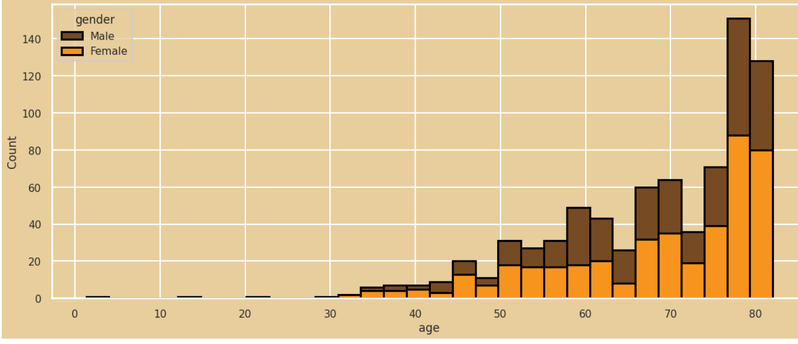
Stroke analysis on Raw Data based on age group:

Slide 7
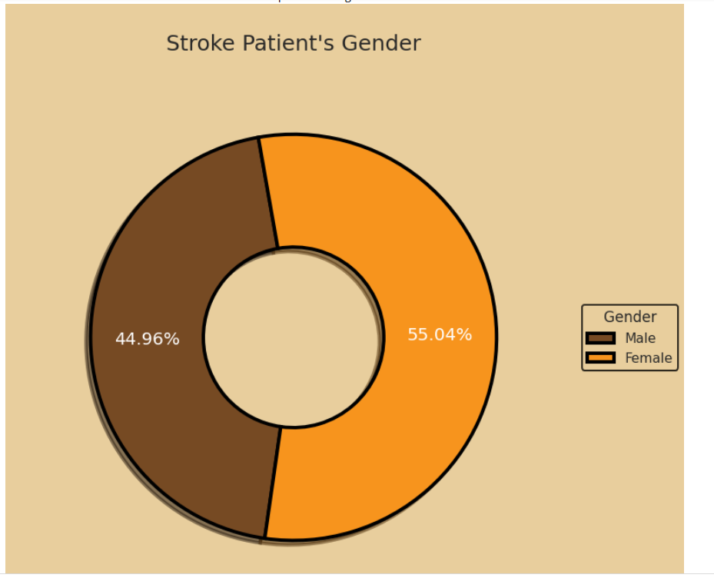
Stroke analysis on Raw Data based on gender:

Slide 8
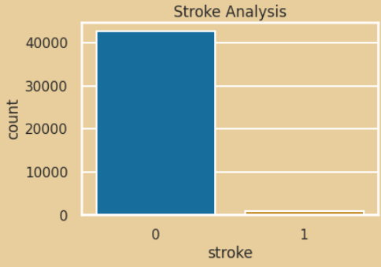
The insignificance of Stroke Data on the Dataset the insignificance:

Slide 9
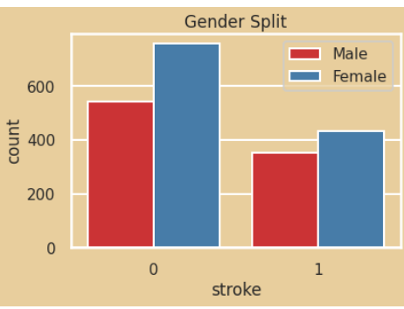
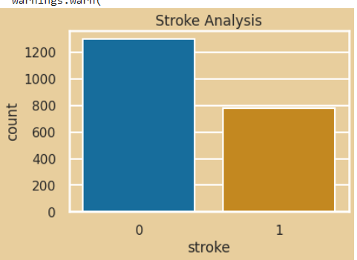
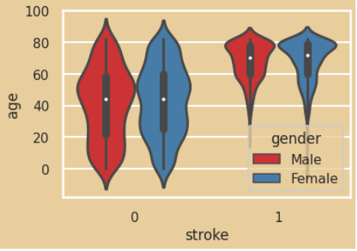
Ratio of people with stroke to noan-stroke in the reduced dataset:

Slide 10
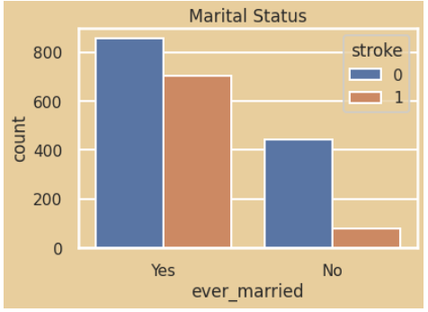
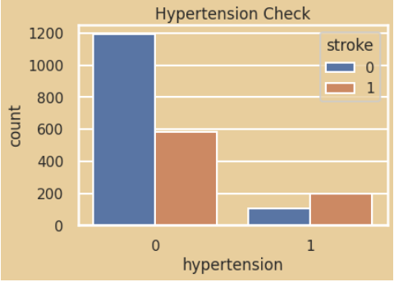
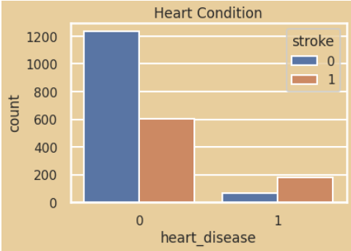
Primary Weightage of other parameters:

Slide 11
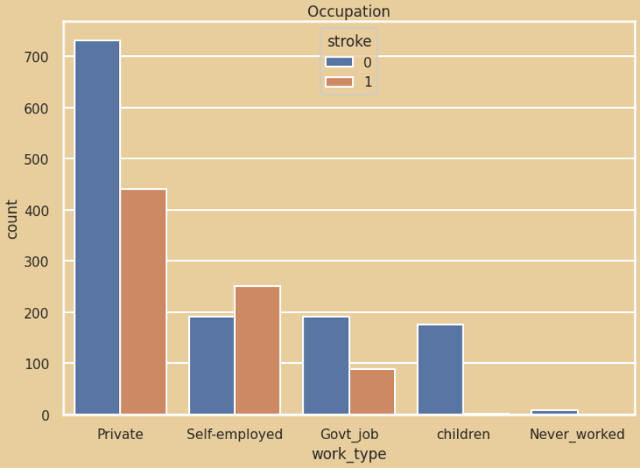
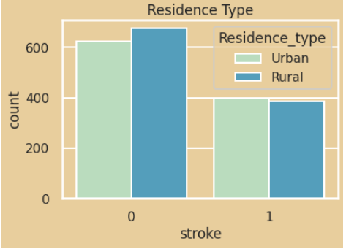
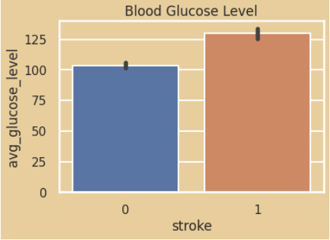
Primary Weightage of other parameters:

Slide 12
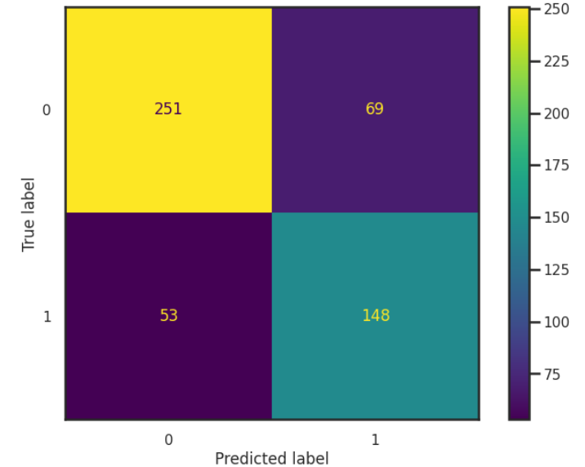
Confusion matrix for reduced dataset:

Slide 13
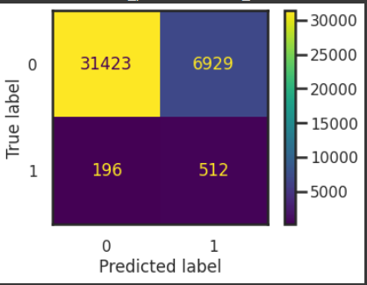
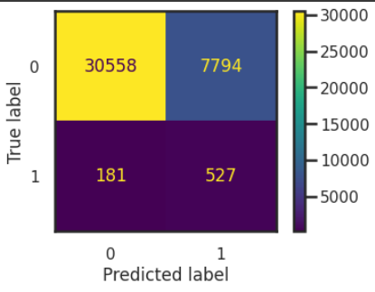
Confusion Matrix for various algorithm over the full dataset:
Logistic Classification
MLP Classification

Slide 14
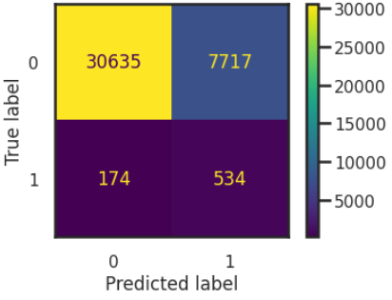
SVM Classification Model:

Slide 15
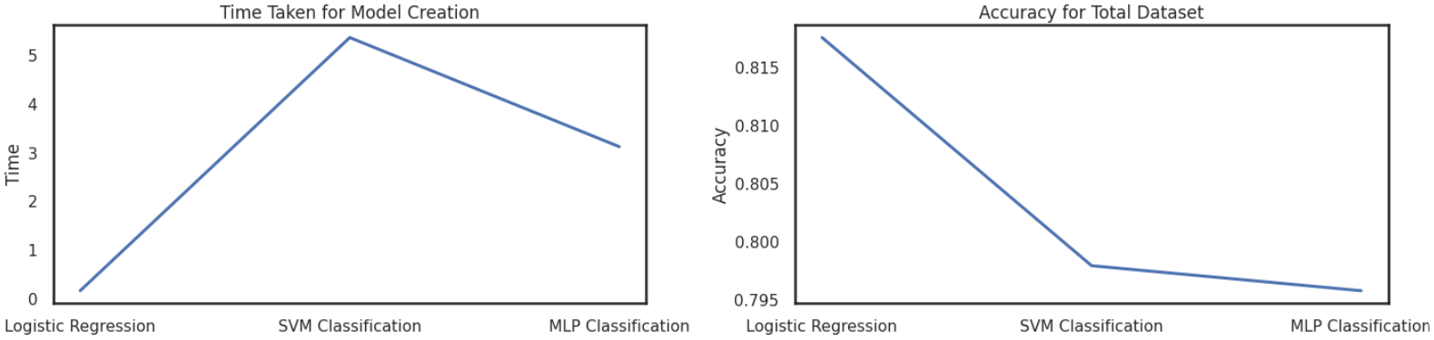
Performance charts for various models:

Slide 16
Conclusion
Our goal with this project is to help identify people who are at risk of suffering from stroke based on their lifestyle and habits. Based on the results of the project, we were able to successfully implement various classification models and compare their performance (accuracy and time-taken). We found that the logistic regression model had the best all-around performance by having the lowest processing time and highest overall accuracy compared to SVM and MLP classification models.

Slide 17
Thank you

